Slide 1
E-news Landing Page Analysis
PGP-DSBA _ E-news Express Project
October 13, 2023

Slide 2
Contents / Agenda
Executive Summary
Business Problem Overview
Solution Approach
EDA Results
Hypotheses Tested and Results
Appendix

Slide 3
Executive Summary: Conclusion (1/2): Exploratory Data Analysis of the Sampled Subjects
On average, the subjects spent about 5 minutes 23 seconds (5.38 minutes) on the landing pages
The spread of the time spent on the landing page is characterized by a range from about 11 seconds (0.19 minutes) to 10 minutes 42 seconds (10.71 minutes) and a standard deviation of about 2 minutes 23 seconds (2.38 minutes)
The randomly selected subjects generated an approximately normal distribution of the time spent on the landing pages
The number of subjects converted is slightly greater (54%) than those not converted
Half of the subjects spent between 4 and 7 minutes on the landing pages and half also spent more 5 minutes
The ratio of subjects converted to those not converted is 27:23
Both Spanish and French are the favorite languages among the subjects (34 each) while English was the preferred language of only 32 subjects
Subjects assigned to the new landing page tended to spend close to two more minutes on the landing page than those assigned to the old landing page
Converted subjects, in general, spent over two more minutes on the landing page than unconverted ones
Subjects having English as preferred language spent the most time on the landing page, closely followed by those whose preferred language is Spanish; the least time spent on the landing page was registered for subjects whose preferred language is French but the differences among the time spent by subjects of the three languages are a few seconds apart

Slide 4
Executive Summary: Conclusion (2/2): Result of Inferential Evaluation of Key Statistical Hypotheses
On average, users spend more time on the new landing page than on the existing one
The rate of conversion for the new page is effectively larger than that for the existing page
The converted status appears to be independent of the preferred language of the user; specifically at the level of significance of 5%
The average time spent on the new page is the same across different language users

Slide 5
Executive Summary: Business Recommendations
We have successfully determined that the new page generates greater engagement by ensuring longer time spent on the page and a greater rate of conversion; so the business might effectively drive increased subscriber acquisition by deploying and continuously ameliorating the new page
We also uncovered that the language choices of the subjects have little or no bearing on the time spent on the new page or conversion rate of users; so language choice might not be a critical business factor for growth
By testing and exploring other factors and design considerations, E-news Express may identify other factors that might drive growth and ameliorate customer experience

Slide 6
Business Problem Overview
E-news Express, an online news portal, has been faced with attrition of its monthly subscriber base for the last couple of months compared to last year. The company’s management is of the opinion that the trend is a result of inadequate design of the landing page, thus not sufficiently attractive to hold users long enough for them to make a decision that registers as a conversion.
After, getting the design team to create a new page with a revamped outline and renewed content in an effort to expand its business and drive growth by acquiring new subscribers, management reached out to the Data Science Team to evaluate the success of this page redesign and its potential business impact.

Slide 7
Solution Approach
The Data Science Team carried out an A/B testing experiment. The experiment was carried out on a sample of 100 subjects split evenly between two groups: The treatment group was assigned to the new landing page and the control group assigned to the old landing page. The group, time spent on the landing page, the conversion status of the subject, the landing page, and the preferred language were registered for each subject. The data thus collected was then analyzed using the following steps to uncover key business insights:
Exploratory Data Analysis of the Sample
Evaluation of Key Hypotheses using Inferential Statistics

Slide 8
EDA Results: Data Overview
Each entry contains the user id, the group to which the subject belongs (control or treatment), the landing page to which they were assigned, the time spent on the page, status information on whether they were converted or not, and their preferred language.
The data appears to consist of a sample of 100 entries
The data collected contains 4 categorical columns (group, landing_page, converted, and language_preferred) and 2 numerical columns (user_id containing integer values and time_spent_on_the_page containing float values)
The user id is a unique identifier; thus no interesting insight can be gained from statistical analysis of its values
The subjects spent about 5 minutes 23 seconds (5.38 minutes) on average on the landing pages
The spread of the time spent on the landing pages is characterized by a range from about 11 seconds (0.19 minutes) to 10 minutes 42 seconds (10.71 minutes) and a standard deviation of about 2 minutes 23 seconds (2.38 minutes)
The average and median time spent on the landing pages are close, suggesting that the distribution is at least slightly normal
The number of subjects converted is slightly greater (54%) than those not converted
From an initial analysis, the most preferred language among the 3 registered languages appears to be Spanish (34%)
Link to Appendix slide on data background check

Slide 9
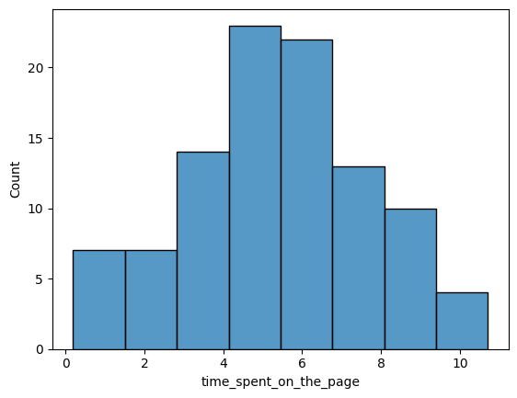
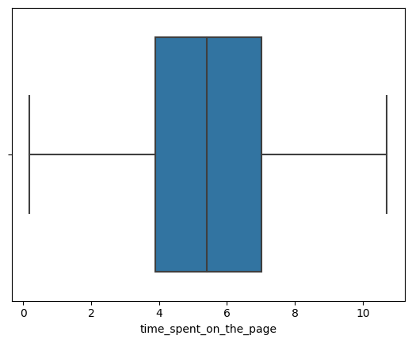
EDA Results: Univariate Analysis: Time spent on the page
We have confirmation that the distribution of the time spent on the landing pages is approximately normal
The time spent on the landing pages has no outliers
Half of the subjects spent between 4 and 7 minutes on the landing pages and half also spent more 5 minutes
Link to Appendix slide on data background check

Slide 10
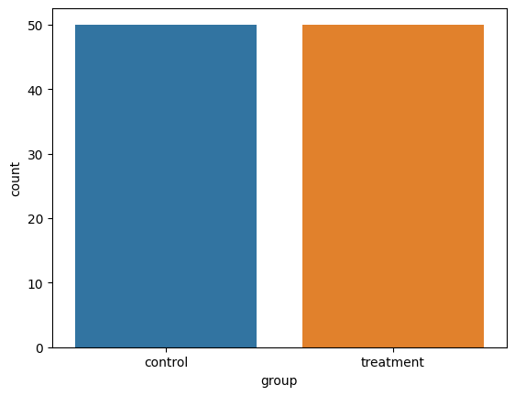
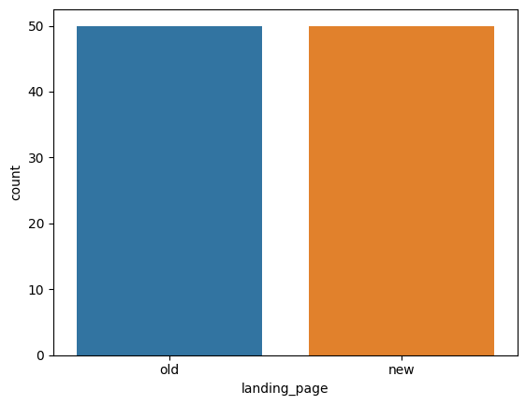
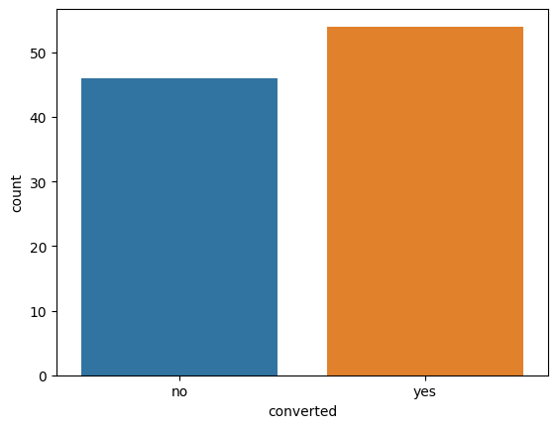
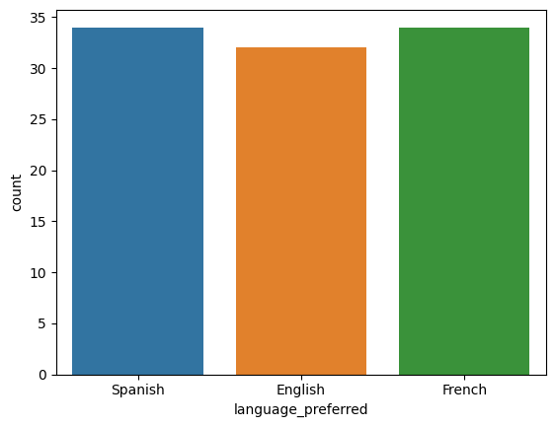
EDA Results: Univariate Analysis: Group, Landing page, Converted Status, Language preferred
We have confirmation that the subjects are equally distributed between the control and treatment groups
We also have confirmation that the subjects are equally distributed between the old and new landing pages
The ratio of subjects converted to those not converted is 27:23
We now have a clearer perspective on the distribution of preferred languages: Both Spanish and French are the favorite languages among the subjects (34 each) while English was the preferred language of only 32 subjects
Link to Appendix slide on data background check

Slide 11
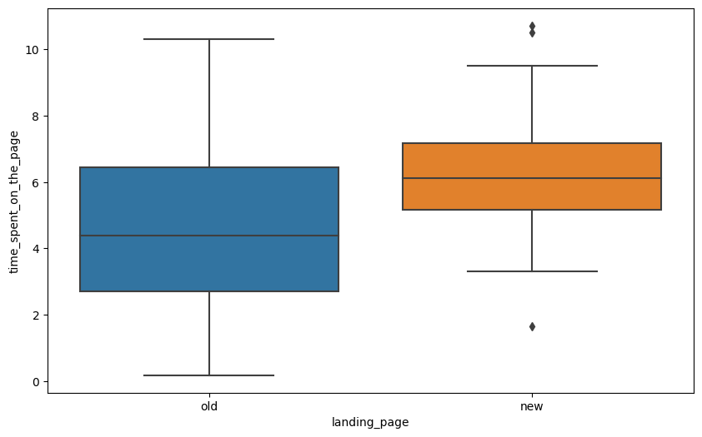
EDA Results: Bivariate Analysis: Landing page vs Time spent on the page
Subjects assigned to the new landing page tended to spend close to two more minutes on the landing page than those assigned to the old landing page
Much larger variability was observed on the time spent on the landing page by the subjects assigned to the old landing page
Some outliers were registered on both sides of the distribution of the time spent on the landing page by subjects assigned to the new landing page
Link to Appendix slide on data background check

Slide 12
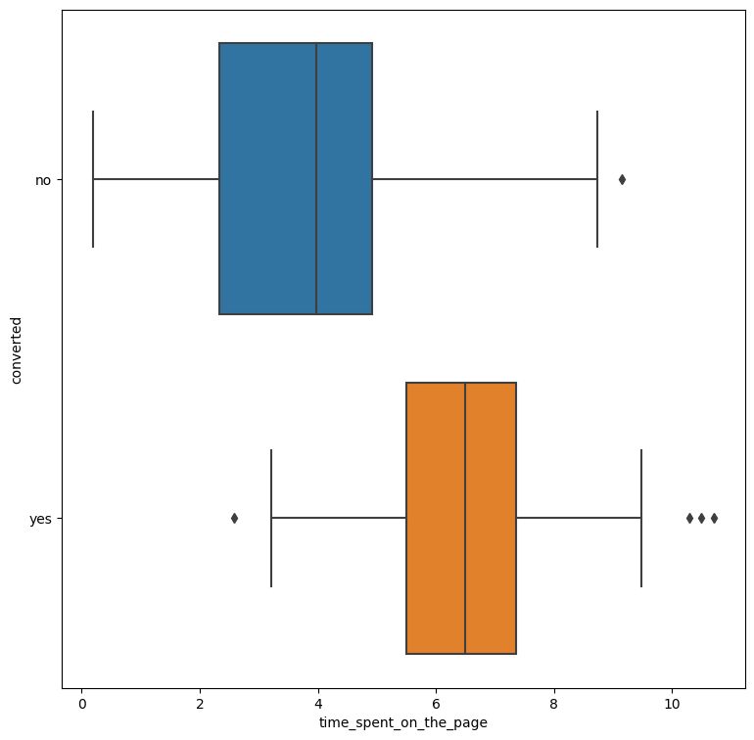
EDA Results: Bivariate Analysis: Conversion status vs Time spent on the page
Converted subjects, in general, spent over two more minutes on the landing page than unconverted ones
A much larger variability of the time spent on the landing page was registered for unconverted subjects
Outliers of time spent on the landing page were registered for both converted and unconverted subjects; converted subjects appear to have many more outliers
Link to Appendix slide on data background check

Slide 13
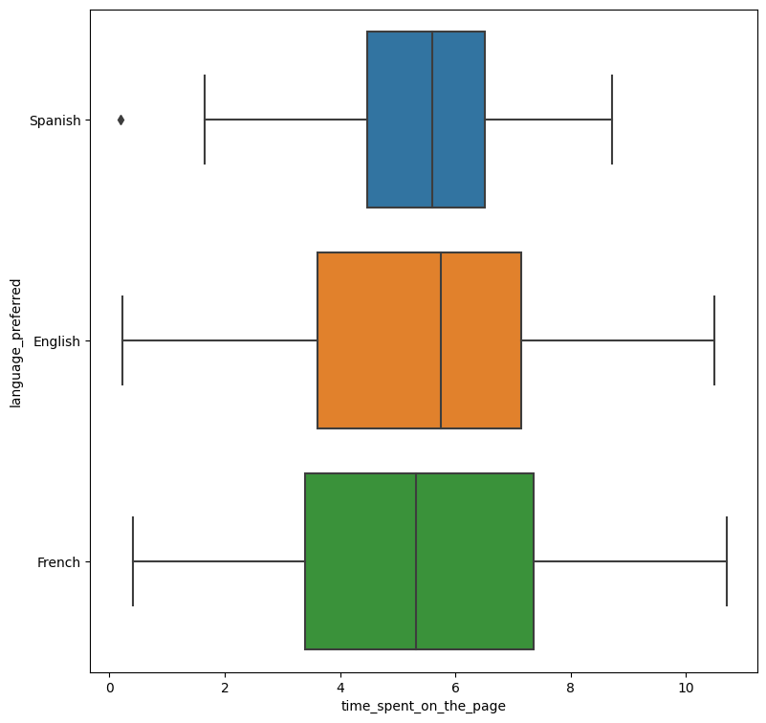
EDA Results: Bivariate Analysis: Language preferred vs Time spent on the page
Subjects having English as preferred language spent the most time on the landing page, closely followed by those whose preferred language is Spanish; the least time spent on the landing page was registered for subjects whose preferred language is French but the differences among the time spent by subjects of the three languages are a few seconds apart
The greatest variability of time spent on the landing page was registered for subjects whose preferred language is French while the least variability was observed for Spanish subjects
At least an outlier was registered to the left of the distribution of time spent on the landing page by subjects whose preferred language is Spanish
Link to Appendix slide on data background check

Slide 14

Hypotheses Tested and Results: Verify whether users spend more time on the new landing page than the existing landing page
Subjects assigned to the new landing page tended to spend close to two more minutes on the landing page than those assigned to the old landing page
Much larger variability was observed on the time spent on the landing page by the subjects assigned to the old landing page
Some outliers were registered on both sides of the distribution of the time spent on the landing page by subjects assigned to the new landing page
Since the p-value (about 0.01%) is less than the level of significance (𝛼 = 5%), we reject the null hypothesis; thus we have sufficient statistical evidence to conclude that users spend more time on the new landing page than on the existing one
Link to Appendix slide on data background check

Slide 15
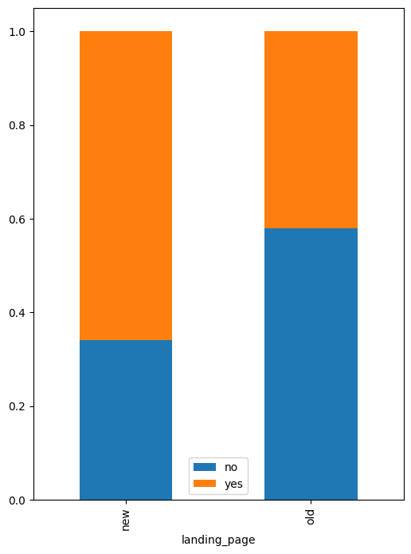
Hypotheses Tested and Results: Verify whether the conversion rate (the proportion of users who visit the landing page and get converted) for the new page is greater than the conversion rate for the old page
From the samples, it appears that the new landing page drove conversion, a hypothesis we will be testing shortly
Since the p-value (about 0.8%) is less than the level of significance (5%), we reject the null hypothesis; we can thus conclude that the rate of conversion for the new page is effectively larger than that for the existing page
Link to Appendix slide on data background check

Slide 16
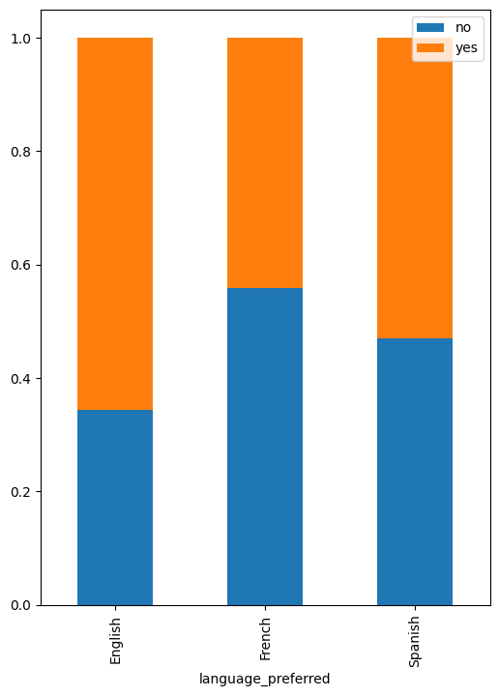
Hypotheses Tested and Results: Verify whether the converted status depend on the preferred language
Subjects whose preferred language is English appear to register the greatest conversion rate whereas French-speaking subjects had the lowest conversion rate
Since the p-value (about 21.3%) is greater than the level of significance (𝛼 = 5%), we fail to reject the null hypothesis. Thus, contrary to our expectation drawn from the descriptive analysis of the sample, the converted status appears to be independent of the preferred language of the user; specifically at the level of significance of 5%
Link to Appendix slide on data background check

Slide 17
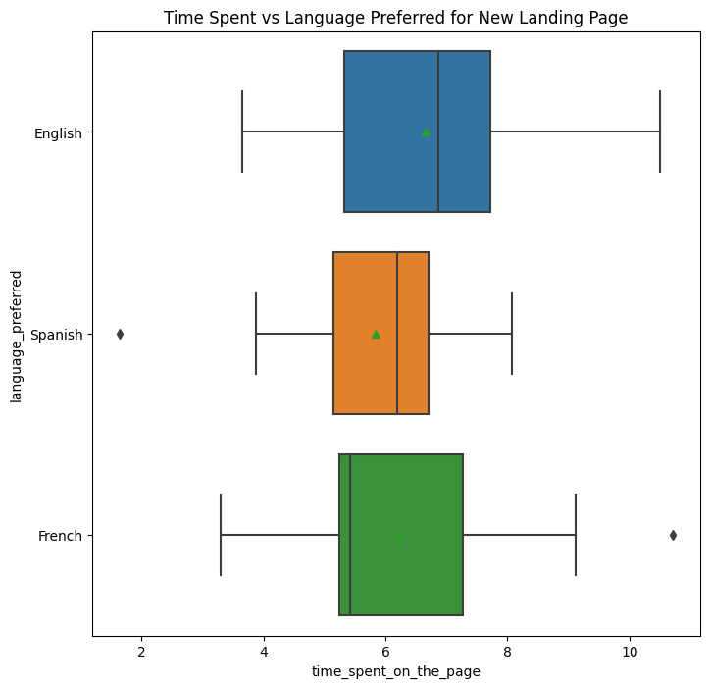
Hypotheses Tested and Results: Verify whether the time spent on the new page same for the different language users
Among subjects assigned to the new landing page, those whose preferred language is English spent the longest time on the landing page whereas French-speaking subjects spent the shortest time on the page
The time spent by English and Spanish subjects is left-skewed and at least a left outlier is registered for Spanish subjects; French subjects have a right-skewed time spent distribution and at least a right outlier
The average time time spent increases from Spanish subjects through French to English subjects; however, the values are pretty close to each other
The time spent by English subjects has the greatest variability whereas that of Spanish subjects is the least variable
Since the p-value (about 43.2%) is greater than the level of significance (𝛼 = 5%), we fail to reject the null hypothesis. So, in line with the observation obtained from the descriptive analysis of the sample (specifically that the means are close to each other), we can conclude that the average time spent on the new page is the same across different language users
Link to Appendix slide on data background check

Slide 18
APPENDIX

Slide 19
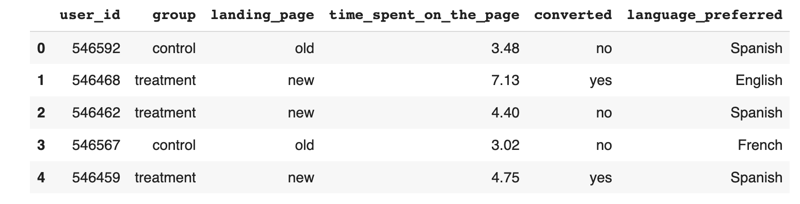
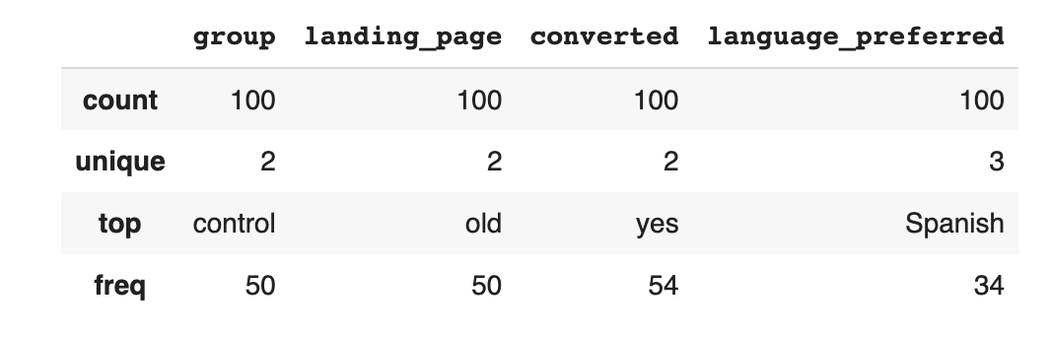
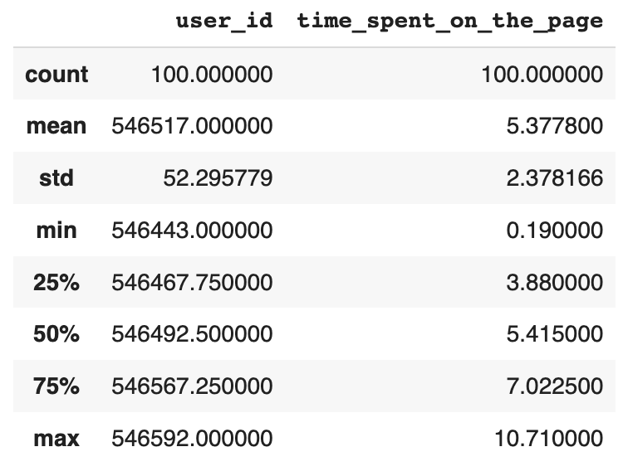
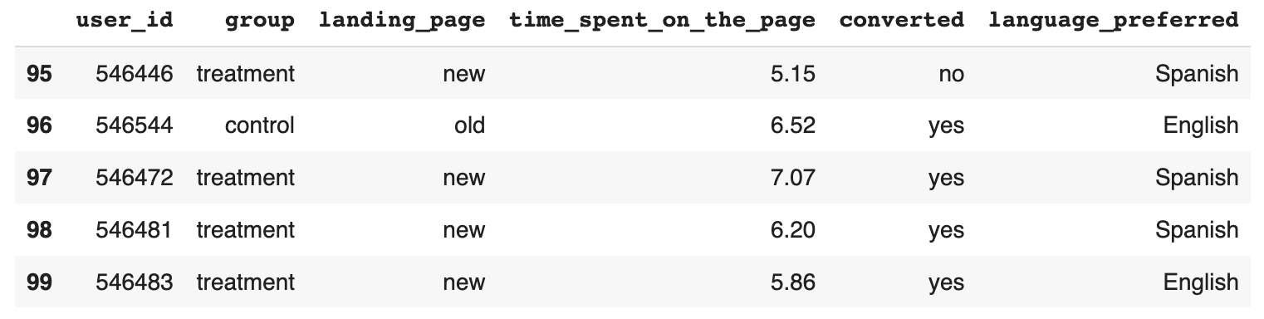
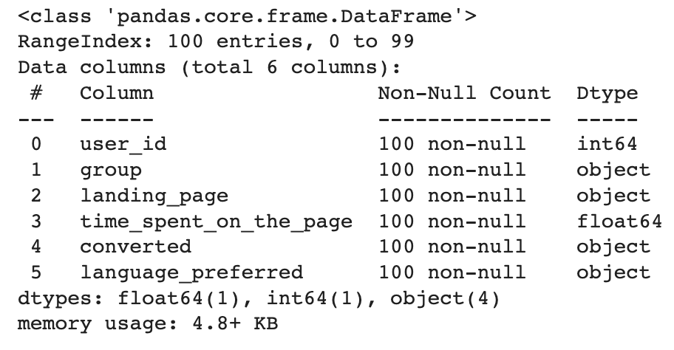
Data Background and Contents: Data Overview

Slide 20
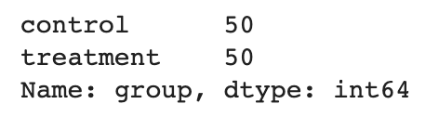
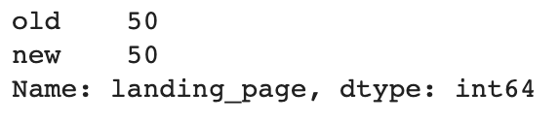
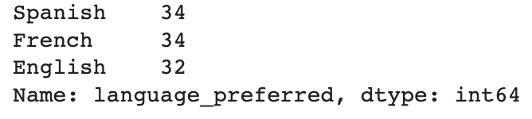
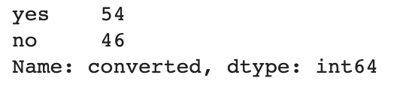
Data Background and Contents: Univariate and Bivariate EDA Analysis
Code snippets:
# Visual plot of time spent distribution
sns.histplot(data=df,x='time_spent_on_the_page')
plt.show()
sns.boxplot(data=df,x='time_spent_on_the_page')
plt.show()
# number of subjects in each group
df['group'].value_counts()
# visual display of groups
sns.countplot(data=df,x='group')
plt.show()
# number of subjects in assigned to each landing page
df['landing_page'].value_counts()
# visual display of landing page distribution
sns.countplot(data=df,x='landing_page')
plt.show()
# number of converted and unconverted subjects
df['converted'].value_counts()
# visual display of conversion distribution
sns.countplot(data=df,x='converted')
plt.show()
# number of subjects per preferred language
df['language_preferred'].value_counts()
# visual display of preferred language distribution
sns.countplot(data=df,x='language_preferred')
plt.show()
#Landing page vs Time spent on the page
plt.figure(figsize=(10,6))
sns.boxplot(data=df,x='landing_page',y='time_spent_on_the_page')
plt.show()
# Conversion status vs Time spent on the page
plt.figure(figsize=(9, 9))
sns.boxplot(data = df, x = 'time_spent_on_the_page', y = 'converted')
plt.show()
# Language preferred vs Time spent on the page
plt.figure(figsize=(9, 9))
sns.boxplot(data = df, x = 'time_spent_on_the_page', y = 'language_preferred')
plt.show()

Slide 21
Hypothesis Testing Details: Average time spent on the new landing page greater than the existing landing page?
Hypotheses:
𝐻0: On average, users spend the same or less time on the new landing page than on the existing landing page
𝐻𝑎: On average, users spend more time on the new landing page than on the existing landing page
Hypothesis Test selected: Since we are analyzing two independent samples and the population standard deviations are unknown, it would be advisable to use the independent two-sample t-test and since the sample standard deviation of the time spent on the old page is almost 1.5 times larger than that of the time spent on the new page, it can be assumed that the corresponding population standard deviations are unequal. So we will be performing Welch’s t-test which does not assume equal population variance
P-value obtained: 0.01%
Code snippets:
# visual analysis of the time spent on the new page and the time spent on the old page
plt.figure(figsize=(8,6))
sns.boxplot(x = 'landing_page', y = 'time_spent_on_the_page', data = df)
plt.show()
# subsetted data frame for new landing page users
time_spent_new = df[df['landing_page'] == 'new']['time_spent_on_the_page']
# subsetted data frame for old landing page users
time_spent_old = df[df['landing_page'] == 'old']['time_spent_on_the_page’]
# import required function
from scipy.stats import ttest_ind
# calculation of p-value
test_stat, p_value = ttest_ind(time_spent_new, time_spent_old, equal_var = False, alternative = 'greater')

Slide 22
Hypothesis Testing Details: Conversion rate (the proportion of users who visit the landing page and get converted) for the new page is greater than the conversion rate for the old page?
Hypotheses:
𝐻0: The rate of conversion for the new page is less than or equal to the conversion rate for the old page
𝐻𝑎: The rate of conversion for the new page is greater than the conversion rate for the old page
Hypothesis Test selected: Since we are analyzing two population proportions from independent populations, we will use proportions z-test
P-value obtained: 0.8%
Code snippets:
# visual comparison of the conversion rate for the new page and the conversion rate for the old page
pd.crosstab(df['landing_page'],df['converted'],normalize='index').plot(kind="bar", figsize=(6,8),stacked=True)
plt.legend()
plt.show()
# computation of the number of converted users in the treatment group
new_converted = df[df['group'] == 'treatment']['converted'].value_counts()['yes’]
# computation of the number of converted users in the control group
old_converted = df[df['group'] == 'control']['converted'].value_counts()['yes’]
n_control = df.group.value_counts()['control'] # total number of users in the control group
n_treatment = df.group.value_counts()['treatment'] # total number of users in the treatment group
# import required function
from statsmodels.stats.proportion import proportions_ztest
# computation of the p-value
test_stat, p_value = proportions_ztest ([new_converted, old_converted] , [n_treatment, n_control], alternative ='larger')

Slide 23
Hypothesis Testing Details: Converted status depends on the preferred language?
Hypotheses:
𝐻0: The converted status of a user is independent of their preferred language
𝐻𝑎: The converted status of users is dependent on their preferred language
Hypothesis Test selected: Since we are dealing with a problem of analyzing the independence of two categorical variables and the number in each cell is greater than 5, we will be using chi-square test of independence
P-value obtained: 21.3%
Code snippets:
# Visual plot of the dependency between conversion status and preferred langauge
pd.crosstab(df['language_preferred'],df['converted'],normalize='index').plot(kind="bar", figsize=(6,8), stacked=True)
plt.legend()
plt.show()
# creation of contingency table showing the distribution of the two categorical variables
contingency_table = pd.crosstab(df['language_preferred'], df['converted'])
# import required function
from scipy.stats import chi2_contingency
# computation of the p-value
chi2, p_value, dof, exp_freq = chi2_contingency(contingency_table)

Slide 24
Hypothesis Testing Details: Time spent on the new page same for the different language users?
Hypotheses:
𝐻0: The time spent on the new page is the same for the different language users?
𝐻𝑎: The time spent on the new page is different for at least one group of language users?
Hypothesis Test selected: Assuming that the time spent on the new page has a normal distribution and that the variances for the three language groups are the same (of course, these are not strict assumptions as observed from the samples; we are considering approximations for practical purposes here; alternatively, we could have verified these assumptions using the Shapiro-Wilk and Levene's tests respectively), we will be using the one-way ANOVA test to evaluate the hypothesis that the time spent on the new page is the same across different language users
P-value obtained: 43.2%
Code snippets:
# new DataFrame for users who got served the new page
df_new = df[df['landing_page'] == 'new']
# visual plot of the time spent on the new page for different language users
plt.figure(figsize=(8,8))
sns.boxplot(x = 'time_spent_on_the_page', y = 'language_preferred', showmeans = True, data = df_new)
plt.title("Time Spent vs Language Preferred for New Landing Page")
plt.show()
# computation of the mean time spent on the new page for different language users
df_new.groupby(['language_preferred'])['time_spent_on_the_page'].mean()
# subsetted data frame of the time spent on the new page by English language users
time_spent_English = df_new[df_new['language_preferred']=="English"]['time_spent_on_the_page’]
# subsetted data frames of the time spent on the new page by French and Spanish language users
time_spent_French = df_new[df_new['language_preferred']== "French"]['time_spent_on_the_page’]
time_spent_Spanish = df_new[df_new['language_preferred']== "Spanish"]['time_spent_on_the_page’]
# import the required function
from scipy.stats import f_oneway
# computation of the p-value
test_stat, p_value = f_oneway (time_spent_English, time_spent_French, time_spent_Spanish)

